Slide 1


Slide 2





Barna Tóth
toakak@gmail.com
https://github.com/Hacklone
@hacklone

Slide 3

#corpjs_bp_questions

Slide 4
Continuous Integration in practice

Slide 5


Or how can 20 developer sit on one branch without breaking it

Slide 6
Continuous Integration
Every commit should be built
Fast builds
Code repository
Auto deployment
Automated build
Self-testing build
Visible results of builds
Everyone commits to baseline every day
Solution for everything

Slide 7

Notes:
BUT – Something is always left out

Slide 8

Want big impact?
Use big image.
Notes:
That nobody really talks about

Slide 9
How to actually do Continuous Integration in practice?

Slide 10

Notes:
We need a HERO – who’d tell us how to create our own CI environment

Slide 11

Notes:
So in this presentation I

Slide 12

Notes:
Won’t tell you how to build your own CI

Slide 13


Slide 14


Slide 15


Slide 16


Slide 18


Slide 19


Slide 20
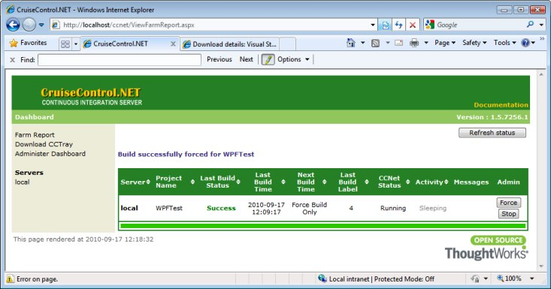



Slide 21
develop
live

Slide 22
No forced code review
1 day long merges
Develop <> Live
Continuous code integration

Slide 23
O Oh…

Slide 24
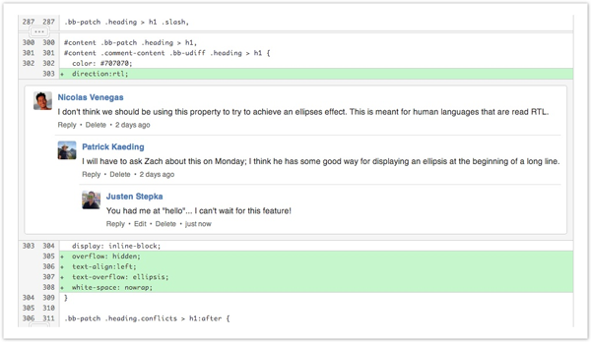



Slide 25
Forced code review
1 day long merges
Develop <> Live
Continuous code integration
Feature branches

Slide 26
O Oh…

Slide 27
live
develop
Pull Request
V 1.0

Slide 28
Forced code review
1 day long merges
Develop == Live
Continuous code integration

Slide 29
Development code can go to live
develop branch is still failing

Slide 30
O Oh…

Slide 31
Test here
develop
Test here

Slide 32

Feature switches

Slide 33

Takes time to master
Infrastructure needed
Sometimes hard to implement

Slide 34


Slide 35
Development code can go to live
develop branch is still failing
develop branch is still failing

Slide 36
O Oh…

Slide 37

Gated Check-in
Satellite sites

Slide 38


Slide 39
Development code can go to live
develop branch is not failing

Slide 40


Slide 41


Slide 42

Complex development flow

Slide 43
O Oh…

Slide 44

What to take home with you?

Slide 45
Continuous Integration IS complex

Slide 46
Continuous Integration needs time and attention

Slide 47
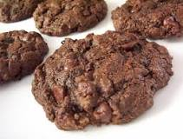
My grandmother’s chocolate cookie recipe
Heat oven to 350°.
In large mixer bowl; cream butter and sugar until light and fluffy.
Add eggs and vanilla; beat well.
Combine flour, cocoa, baking soda and salt; gradually blend into creamed mixture. ...
Drop by teaspoonfuls onto ungreased cookie sheet. ...
Cool slightly; remove from cookie sheet onto wire rack.

Slide 48
Continuous Integration still in early phase

Slide 49
O Oh…

Slide 50
#corpjs_bp_questions

Slide 51
Barna Tóth
toakak@gmail.com
https://github.com/Hacklone
@hacklone

